Slide 1

UNIVERSITY INSTITUTE OF ENGG.
UIE ACADEMIC UNIT-2
Bachelor of Engineering (Computer Science & Engineering) Digital Electronics ECT-155
Prepared By:- Er. Ravneet Kaur
FULL ADDER
DISCOVER . LEARN . EMPOWER

Slide 2

FULL ADDER
Course Outcome
CO Number | Title | Level
CO1 | Merits of digital systems , various number systems and their applications. | Remember and understanding
CO2 | Combinational and sequential digital designing and solution to basic circuits. | Applying and Analyzing
CO3 | Designing of sequential circuits and introduction to memory design logics. | Evaluating and creating
Figure 1.1 Practical application of Full Adder [4]

Slide 3
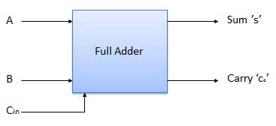
FULL ADDER
Full adder is a combinational logic circuit which add two input binary bits and previous carry and will result sum and carry as output variables.
Figure 1.2 Block diagram of FA [1]

Slide 4
FULL ADDER
TRUTH TABLE
A | B | C_{in} | _{S} | c
0 | 0 | 0 | 0 | 0
0 | 0 | 1 | 1 | 0
0 | 1 | 0 | 1 | 0
0 | 1 | 1 | 0 | 1
1 | 0 | 0 | 1 | 0
1 | 0 | 1 | 0 | 1
1 | 1 | 0 | 0 | 1
1 | 1 | 1 | 1 | 1

Slide 5
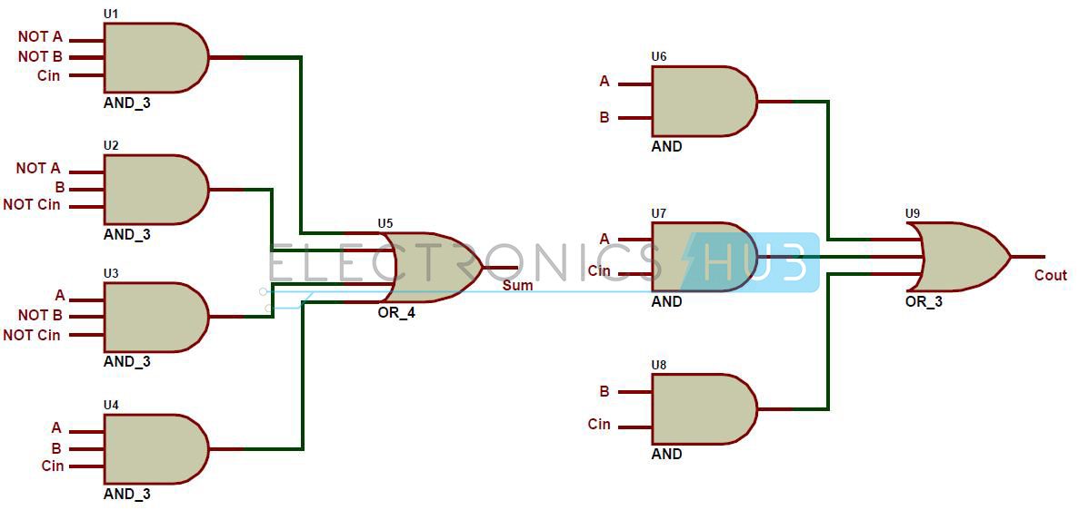
FULL ADDER
BOOLEAN EXPRESSION:
s=Á’B’ C_{in}+A’BC_{in}’+AB’ C_{in}’+ABC_{in}
c=AB+BC_{in}+C_{in}A
Figure 1.3 Logic Diagram using basic gates [2]

Slide 6
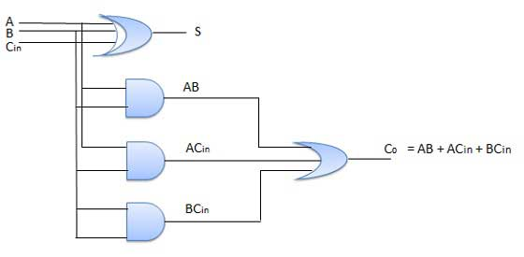
FULL ADDER
After Simplifying the Boolean Expression we obtain the following equation:
s= (A ⊕ B) ⊕ Cin
C=Cin(A ⊕ B)
Figure 1.4 Logic diagram of FA [1]

Slide 7
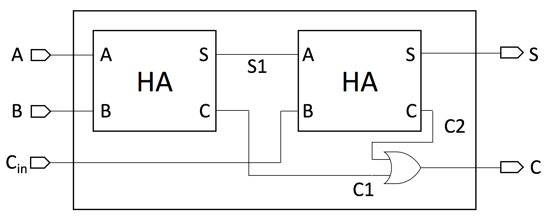
FULL ADDER
Figure 1.5 Logic diagram of FA using HA [3]

Slide 8
Assessment Pattern
Design full adder using 2 half adders
Design full adder using gates
Design a full adder using only Basic Gates.

Slide 9
APPLICATIONS
In ALU
Calculators
Delay Circuits

Slide 10
REFERENCES
https://www.tutorialspoint.com/computer_logical_organization/combinational_circuits.htm
https://www.google.com/url?sa=i&url=https%3A%2F%2Fwww.electronicshub.org%2Fhalf-adder-and-full-adder-circuits%2F&psig=AOvVaw3EEvl_U-utnhFfMkLwl-5x&ust=1595879743706000&source=images&cd=vfe&ved=0CAIQjRxqFwoTCKja3bzZ6-oCFQAAAAAdAAAAABAP
https://www.google.com/url?sa=i&url=https%3A%2F%2Ftechyelf.blogspot.com%2F2017%2F09%2Fvhdl-code-for-full-adder-using-half.html&psig=AOvVaw2hfmDDKfQ5KlYO-MCeAhTk&ust=1595880483842000&source=images&cd=vfe&ved=0CAIQjRxqFwoTCNi1lKTc6-oCFQAAAAAdAAAAABAa
https://www.google.com/url?sa=i&url=https%3A%2F%2Fwww.wired.com%2Fstory%2Fyou-can-power-a-calculator-with-some-leds%2F&psig=AOvVaw04qq4sVg6HobtSKaimt6_4&ust=1595881474357000&source=images&cd=vfe&ved=0CAIQjRxqFwoTCNDS9f7f6-oCFQAAAAAdAAAAABAc
Mano,Morris, Digital Design, Prentice Hall of India.
Fletcher, An Engg. Approach to digital design, Prentice Hall of India.

Slide 11
THANK YOU
For queries
Email: navdeepkaur.ece@cumail.in

